Slide 1
CAB RIDE AND PRICE
SUBMIT BY –
Vikas Data
Al Wasi Khan
Sandipta Subir Khare

Slide 2
COLUMNS IN THE DATASET
INDEX([‘VendorID’, ‘tpep_pickup_datetime’, ‘tpep_dropoff_datetime’, ‘passenger_count’, ‘trip_distance’, ‘RatecodeID’, ‘store_and_fwd_flag’, ‘PULocationID’, ‘DOLocationID’, ‘payment_type fare_amount’, ‘extra’, ‘mta_tax’, ‘tip_amount’, ‘tolls_amount’, ‘improvement_surcharge’, ‘total_amount’])

Slide 3
In today’s world there is highest usage of cabs such as UBER, OLA and LYFT. These cabs services are more cheaper than passenger’s own private vehicle. According to many passengers, buying new car and then maintaining it which includes the car’s insurance policy is expensive as compare to cabs.
The objective of using classification is to predict the usage of cabs. With the help of classification we had minimize the prediction error and maximize the accuracy.
The Dataset which we had selected is labelled data and hence comes under the supervised learning technique. Classification is the problem of identifying to which of a set of categories (sub-populations) a new observation belongs, on the basis of a training set of data containing observations (or instances) whose category membership is known.
There are a total of 17 columns and 1048576 rows labels included.

Slide 4
Linear Classifier: Linear classifier is a statistical regression method which is used for predictive analysis. Linear regression shows the linear relationship between the independent variable (X-axis) and the dependent variable (Y-axis), hence called linear regression. If there is only one input variable (x), then such linear regression is called simple linear classifier. And if there is more than one input variable, then such linear regression is called multiple linear classifier.
KNN (K Nearest Neighbors) Algorithm Classification: The KNN algorithm assumes that similar things exist in close proximity. In other words, similar things are near to each other.
Support Vector Machine(SVM): Support Vector Machine(SVM) is quite different than other Regression models. Support Vector Regression tries to fit the best line within a predefined or threshold error value.
Decision Trees: Decision Tree is a supervised learning algorithm which can be used for solving both classification and regression problems. It can solve problems for both categorical and numerical data. Decision Tree regression builds a tree-like structure in which each internal node represents the "test" for an attribute, each branch represent the result of the test, and each leaf node represents the final decision or result..
Random Forests: Random forest is one of the most powerful supervised learning algorithms which is capable of performing regression as well as classification tasks. The Random Forest regression is an ensemble learning method which combines multiple decision trees and predicts the final output based on the average of each tree output.

Slide 5
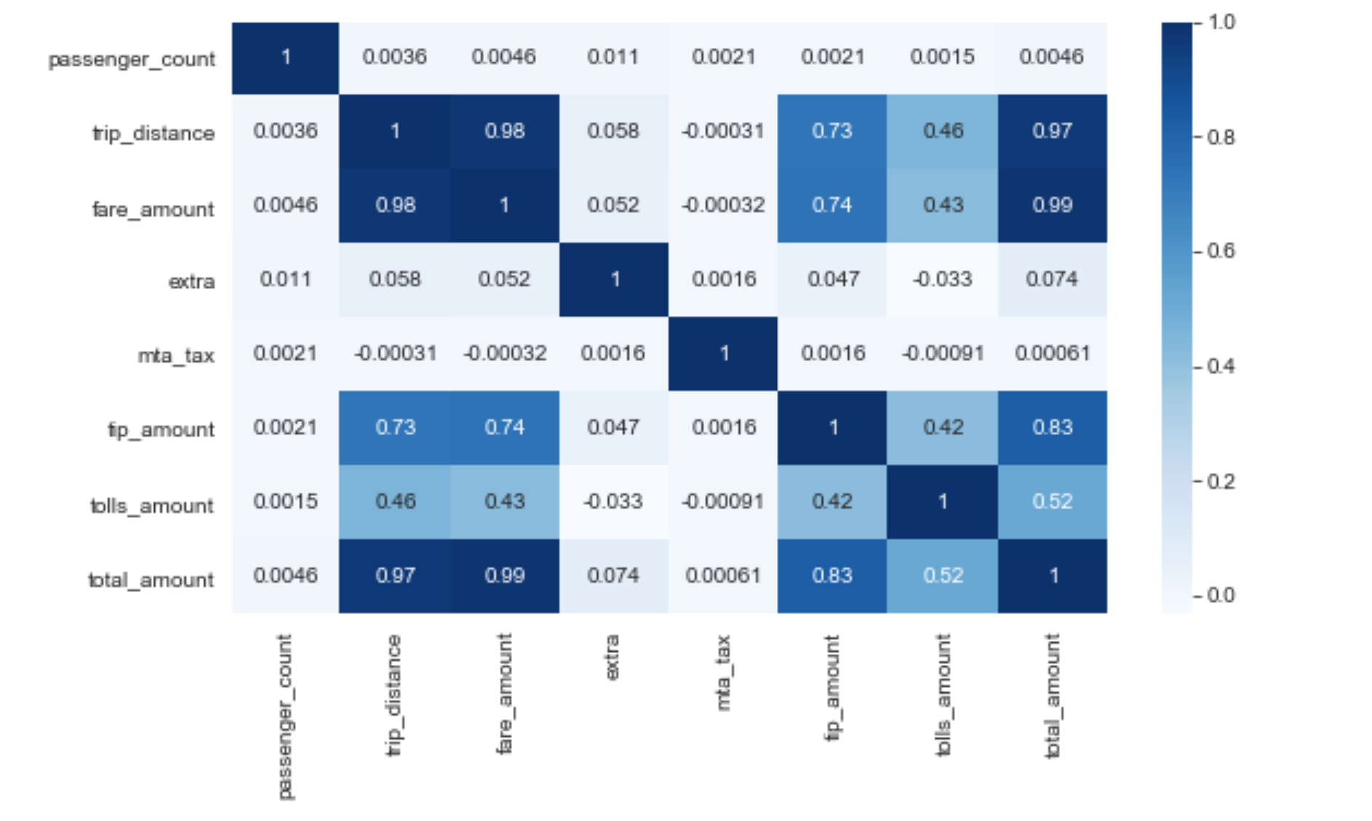
CORRELATION MATRIX

Slide 6
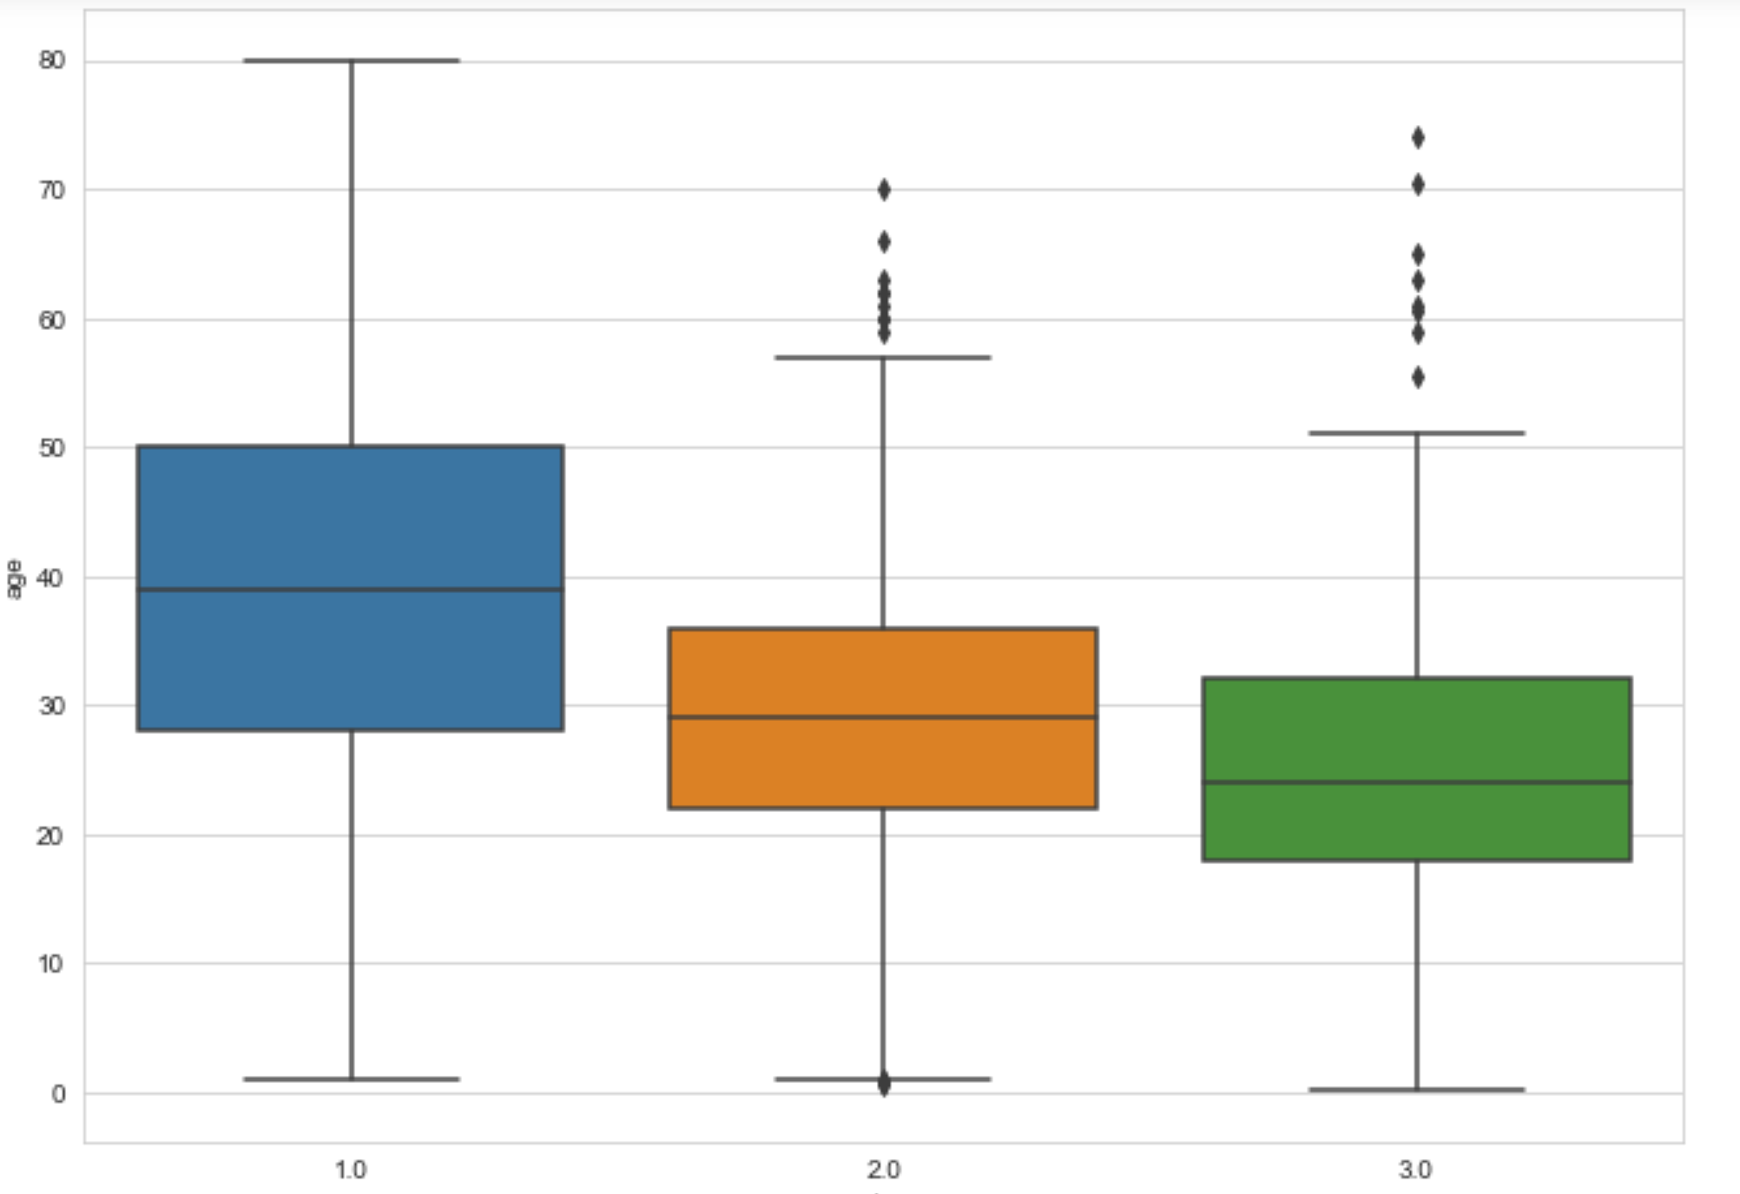
BOX PLOT

Slide 7
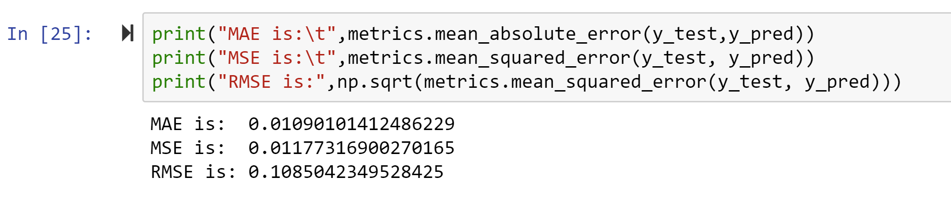
LINEAR CLAISSIFIER

Slide 8
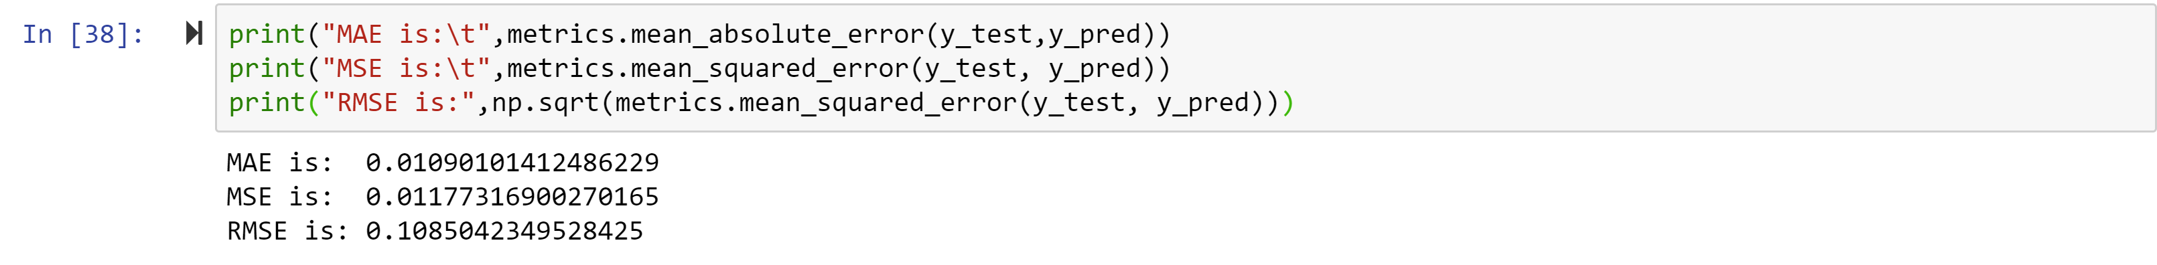
LOGISTIC REGRESSION PREDICTION ERROR

Slide 9
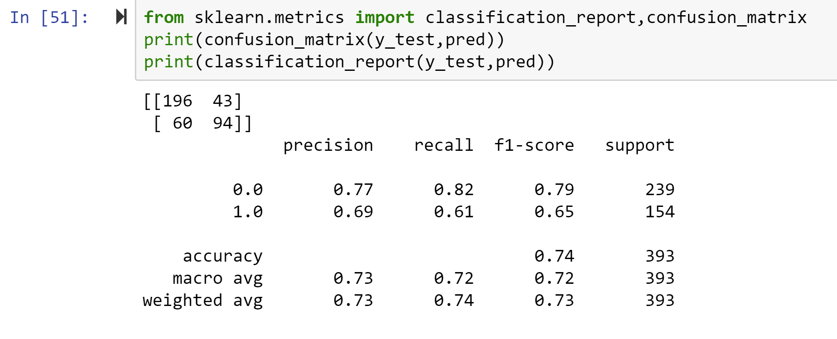
KNN ALGORITHM CLASSIFICATION REPORT AND CONFUSSION MATRIX

Slide 10
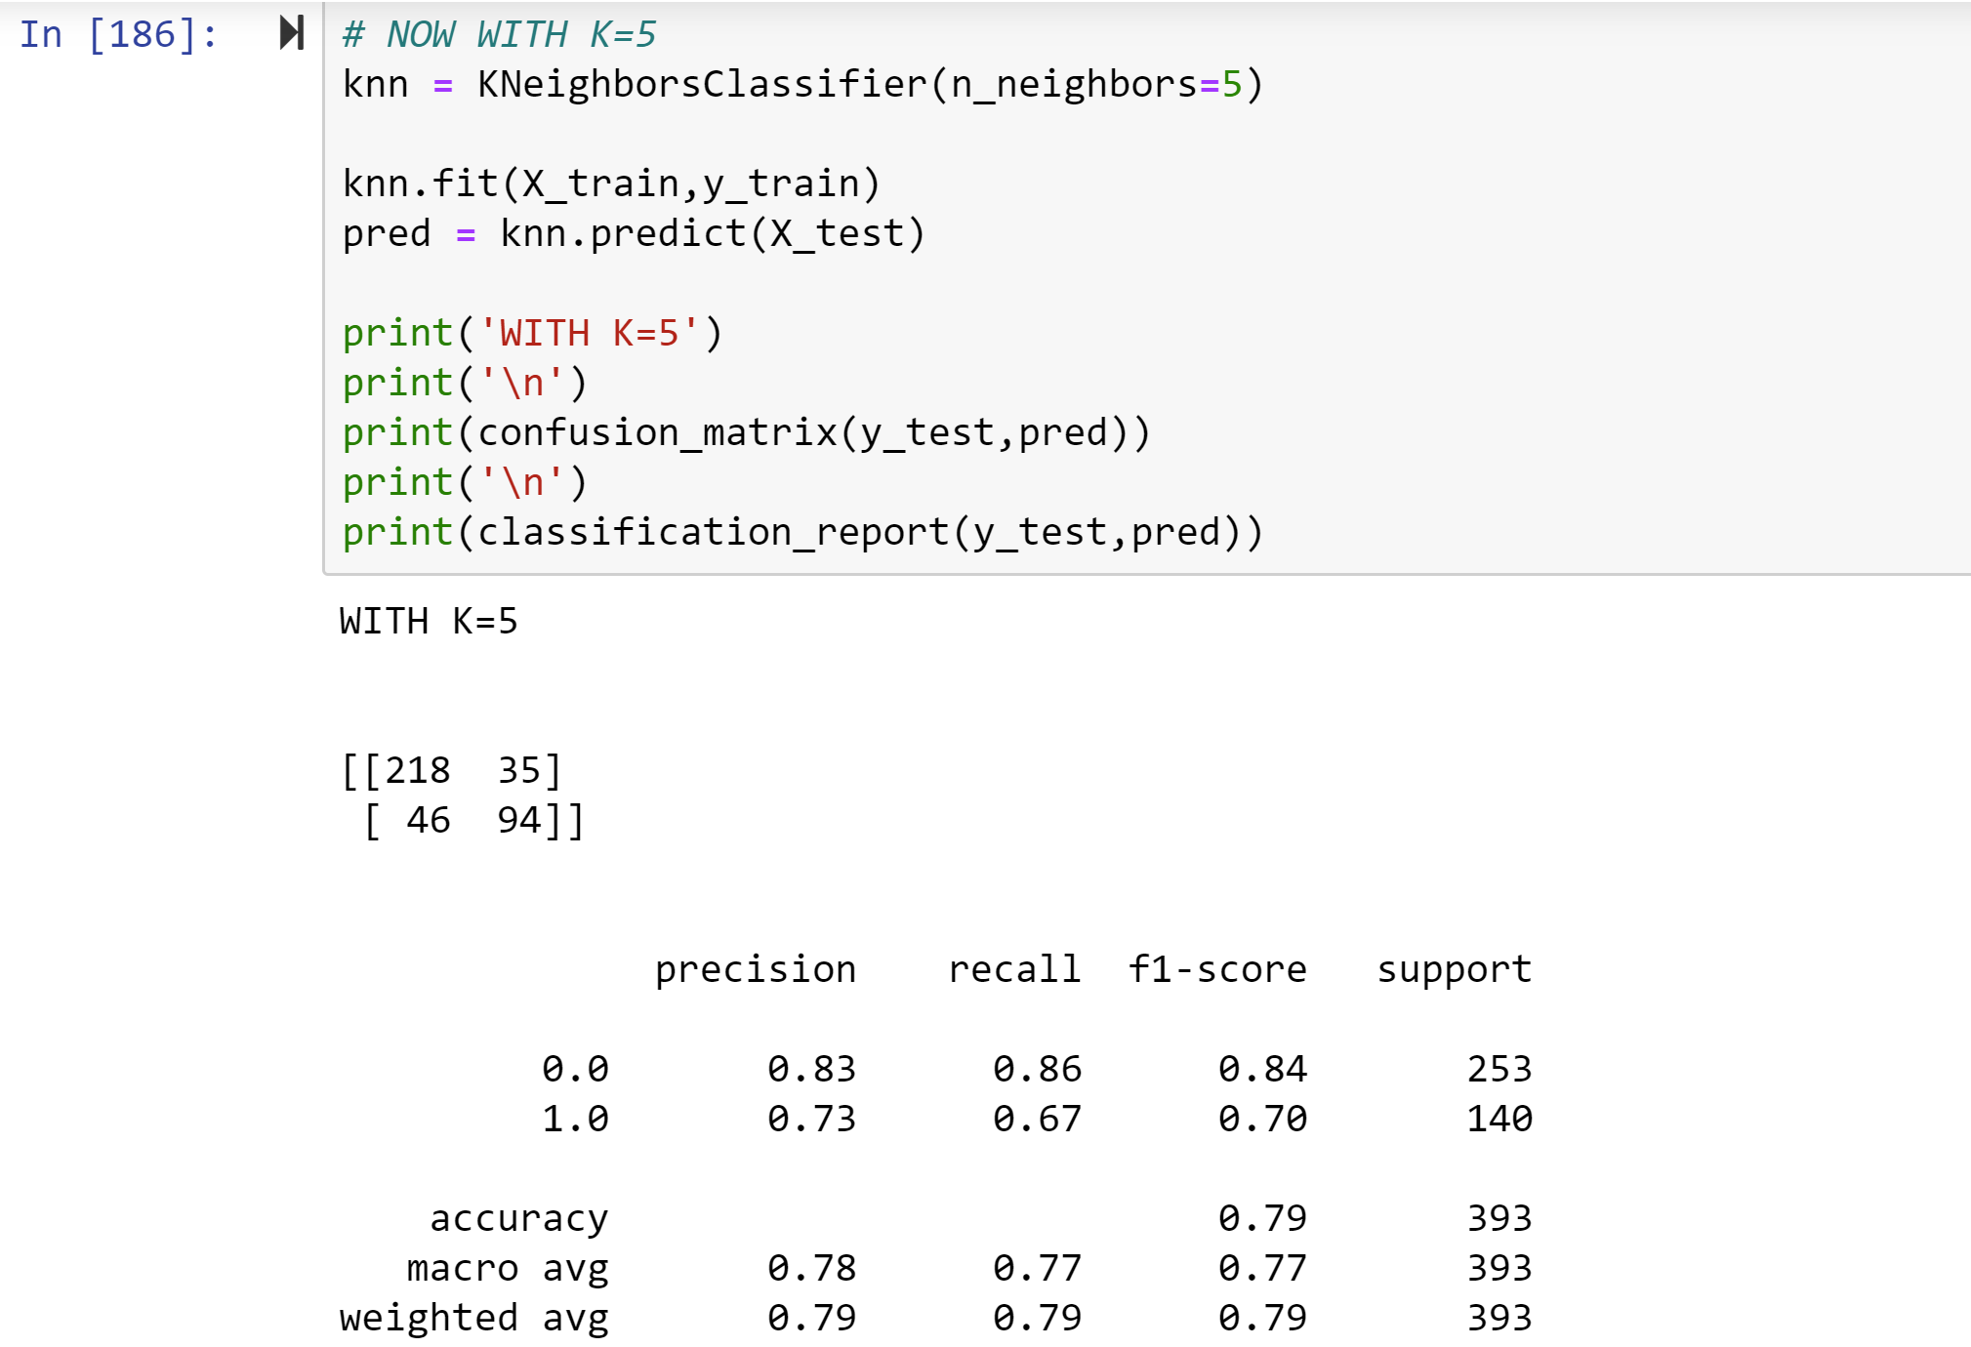
KNN ALGORITHM ACCURACY

Slide 11
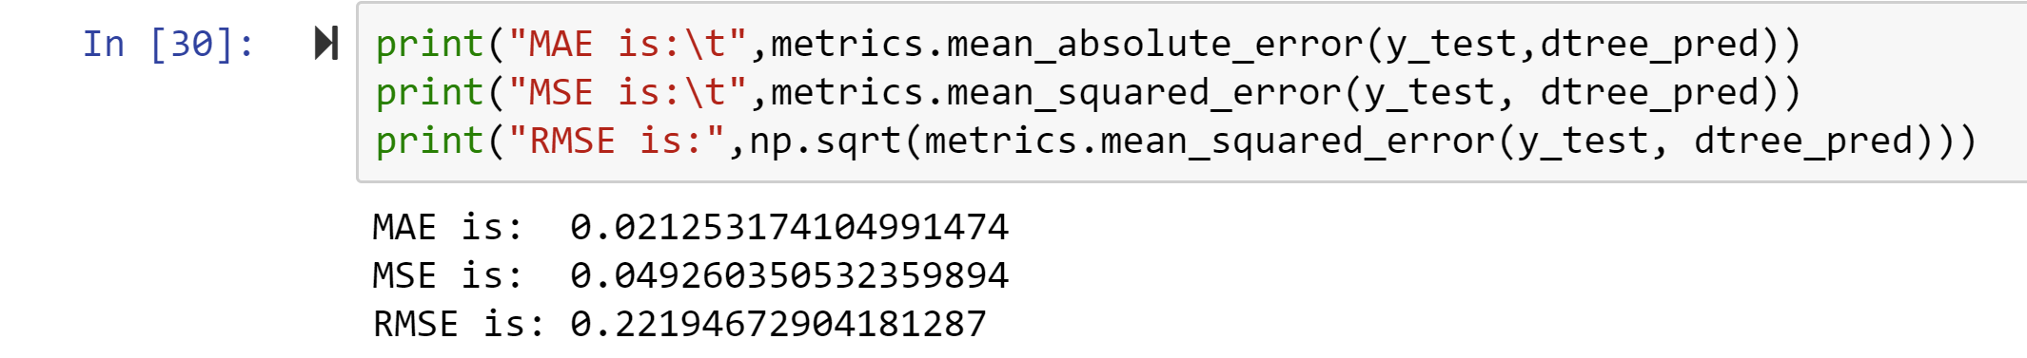
DECISION TREE PREDICTION ERROR

Slide 12
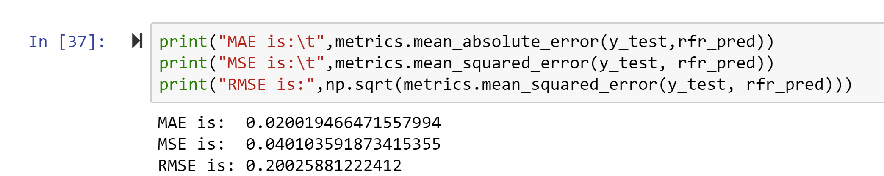
RANDOM FOREST PREDICTION ERROR

Slide 13
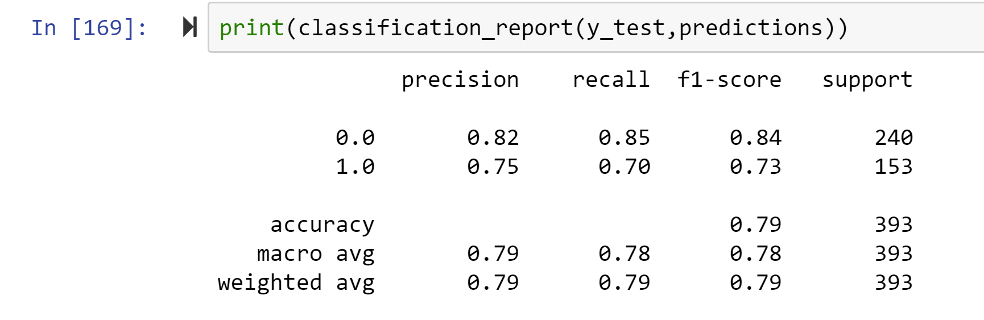
LOGISTIC REGRESSION ACURACY

Slide 14
CONCLUSION
After performing the algorithims and looking at the metrics we can say that everything performed quiet well. But by considering the metrics for regression we can say that Multiple Linear Regression performed seemingly well.

